Slide 1
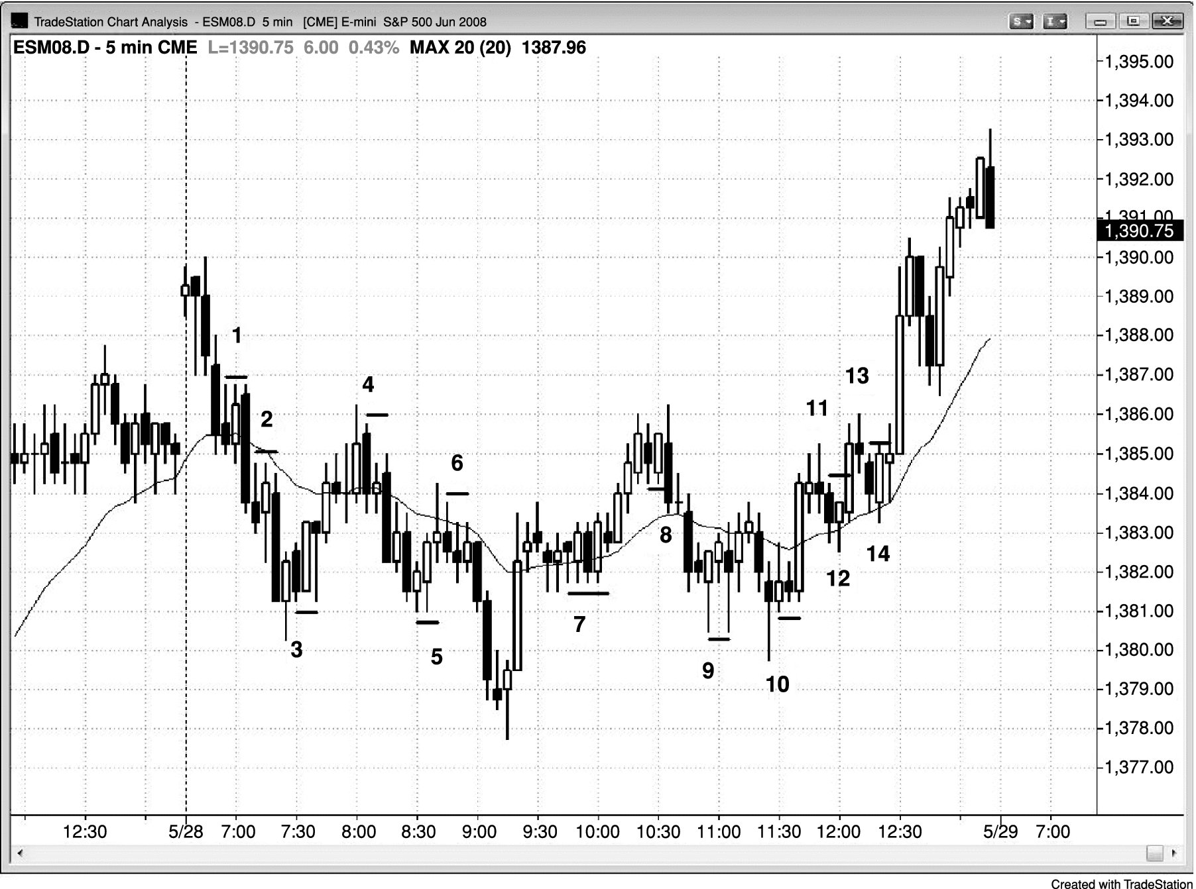
FIGURE 29.1 The Initial Stop Is Just beyond the Signal Bar

Slide 2
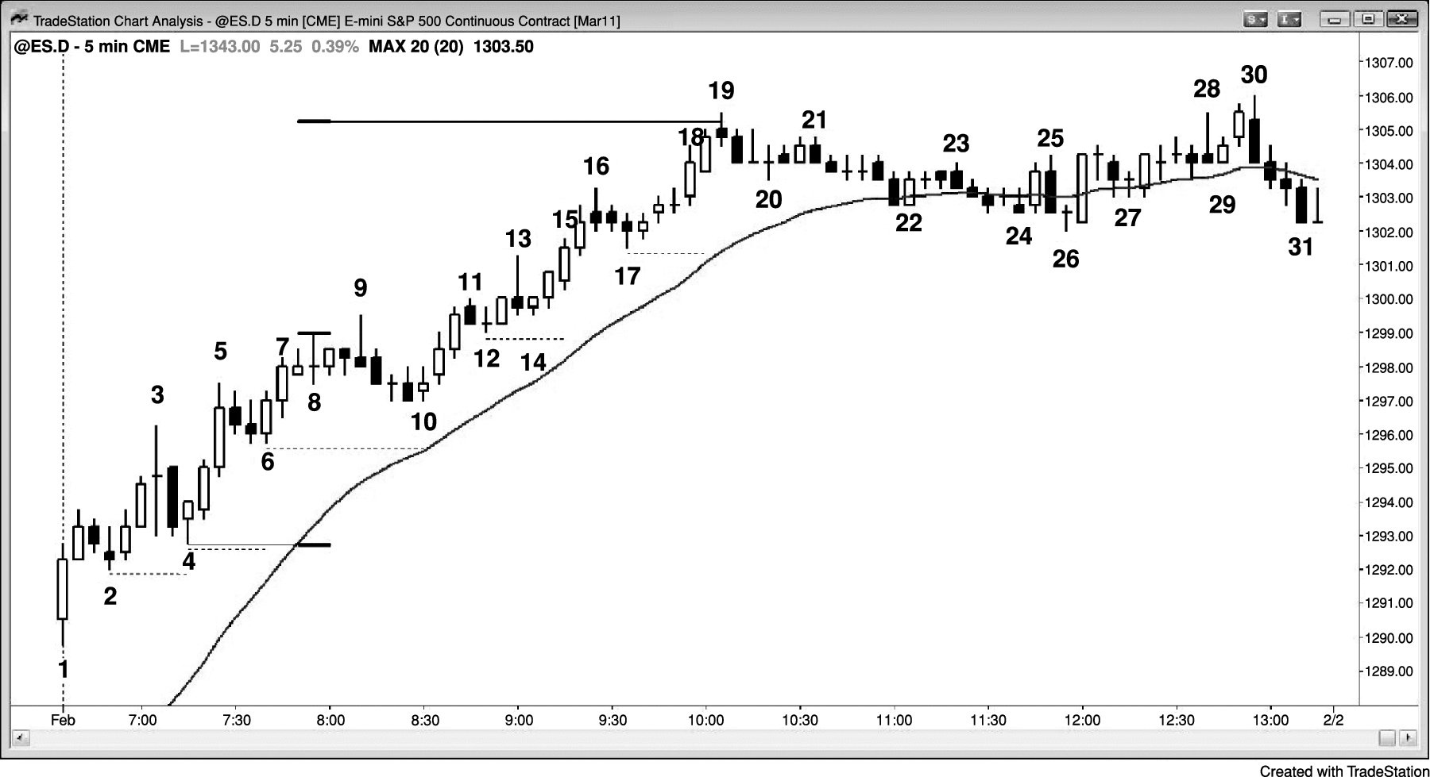
FIGURE 29.2 Trailing Stops in a Strong Bull Trend

Slide 3
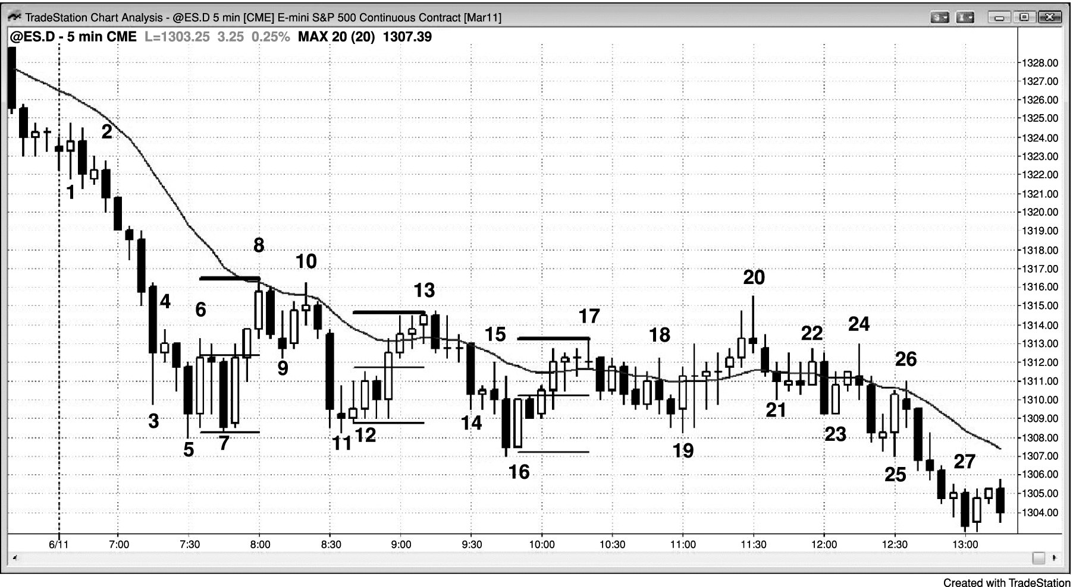
FIGURE 29.3 Reward Often Equals Risk

Slide 4
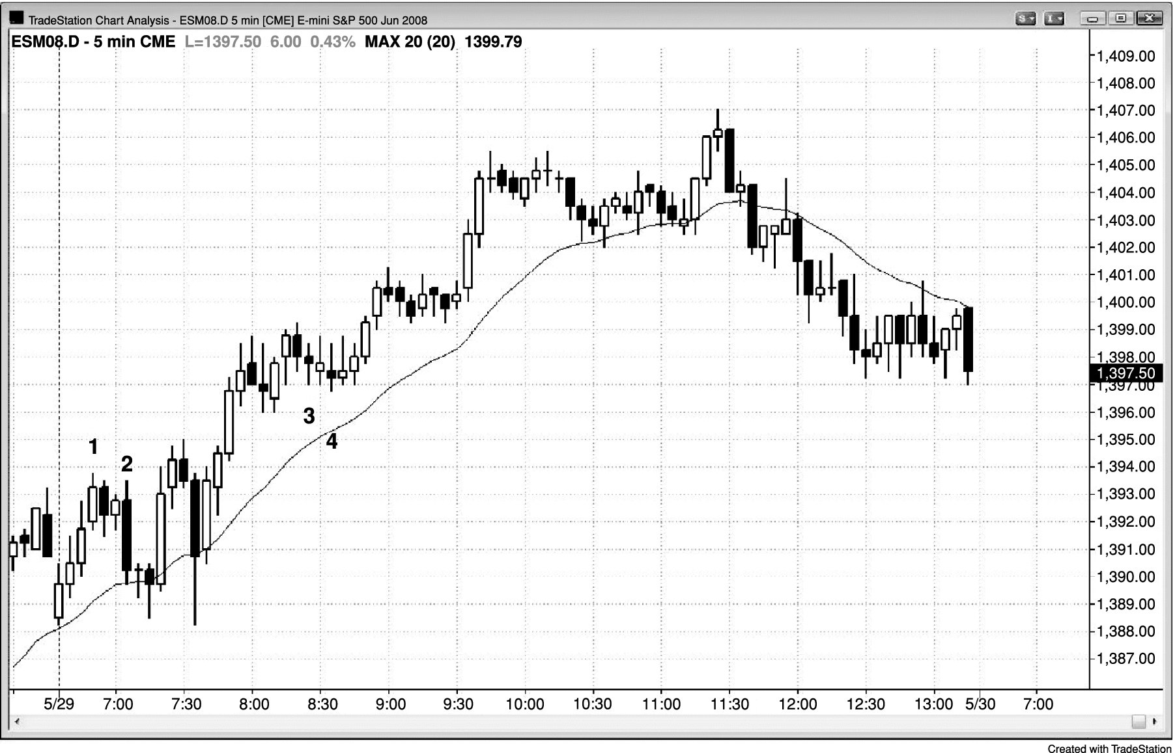
FIGURE 29.4 The Stop Size Is Often Set by the First Trade of the Day

Slide 5
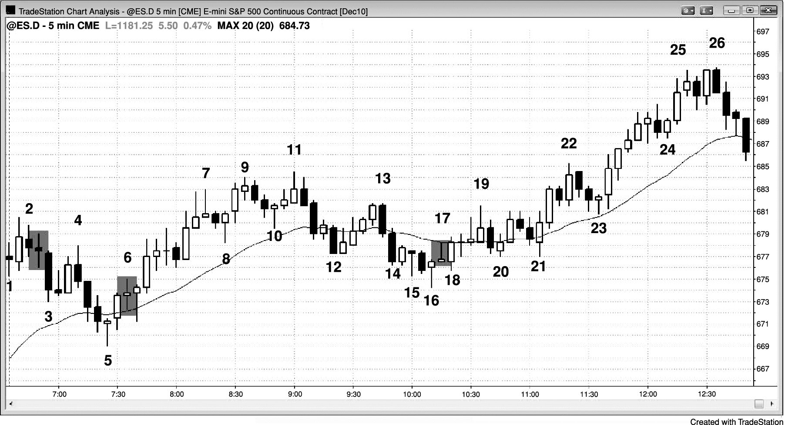
FIGURE 29.5 Don’t Tighten Stops Too Soon

